Slide 1
HR Analytics – Employee Attrition Prediction Analysis Date: June 26, 2025 Prepared by: PAROMITA SAHA

Slide 2
CONTENT
Project Purpose
Introduction
Data Cleaning & Transformation
Data Analysis
Overall Attrition
Over Time vs Attrition
Work-Life Balance vs Attrition
Monthly Income vs Attrition
Job Satisfaction vs Attrition
Job Role vs Attrition
Model Building & Evaluation
Logistic Regression
Random Forest
XGBoost
Voting Classifier (Ensemble)
Conclusion & Recommendation

Slide 3
Project Purpose
The primary objective of this project is to develop a robust machine learning model capable of predicting whether an employee is likely to leave the organization. This prediction is based on historical data and various work-related factors, aiming to provide valuable insights for HR decision-making.

Slide 4
Introduction to Employee Attrition Prediction
What is Employee Attrition?
Employee attrition refers to the voluntary or involuntary departure of employees from a company through resignation, retirement, or termination.
High attrition can lead to increased recruitment costs, loss of institutional knowledge, and decreased productivity.
Why Predict Attrition?
Proactive Retention: Identify employees at risk of leaving to implement targeted retention strategies.
Talent Management: Understand underlying reasons for attrition to improve employee satisfaction and work environment.
Cost Savings: Minimize costs associated with recruitment, onboarding, and training new employees.
Workforce Planning: Better forecast staffing needs and manage talent pipelines.

Slide 5
Data Cleaning & Transformation
Handling Missing Values
No missing values were identified, eliminating the need for imputation or removal of rows/columns due to missing data.
Feature Engineering / Transformation
Column Dropping: The following unnecessary columns were dropped as they do not contribute to the predictive power of the model: EmployeeNumber, EmployeeCount, Over18, StandardHours.
Categorical Variable Conversion:
Label Encoding: The Attrition column (Yes/No) was label encoded, mapping 'Yes' to 1 and 'No' to 0. Similarly, binary categorical columns like Gender and OverTime were label encoded.
One-Hot Encoding: The remaining categorical variables (non-binary) were converted using one-hot encoding to avoid imposing ordinal relationships.
Feature Scaling: Numerical features such as Age, MonthlyIncome, DistanceFromHome, YearsAtCompany, and TotalWorkingYears were scaled using StandardScaler to normalize their ranges, which is crucial for many machine learning algorithms.

Slide 6
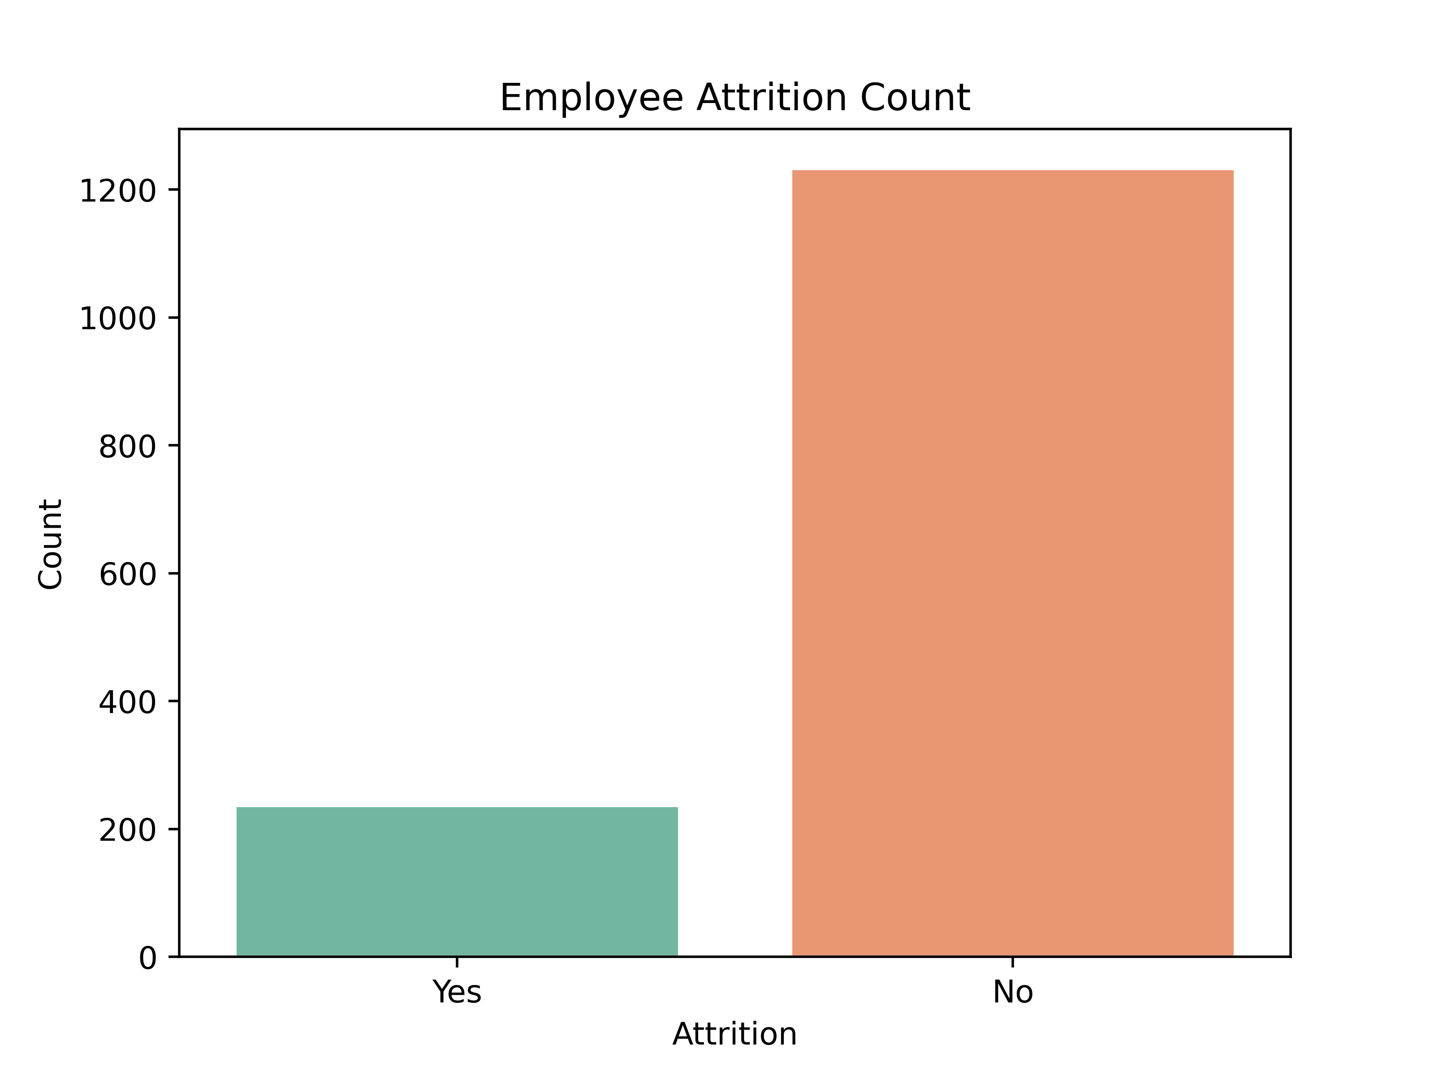
Data Analysis
1. Overall Attrition Distribution
Key Insight: The dataset shows the overall distribution of attrition within the employee base.
Observations:
A smaller proportion of employees are identified as having Attrited (Yes).
A significantly larger group of employees have Not Attrited (No).
Implication: While a majority of employees are retained, understanding the factors influencing the 'Yes' group is crucial for targeted interventions.

Slide 7
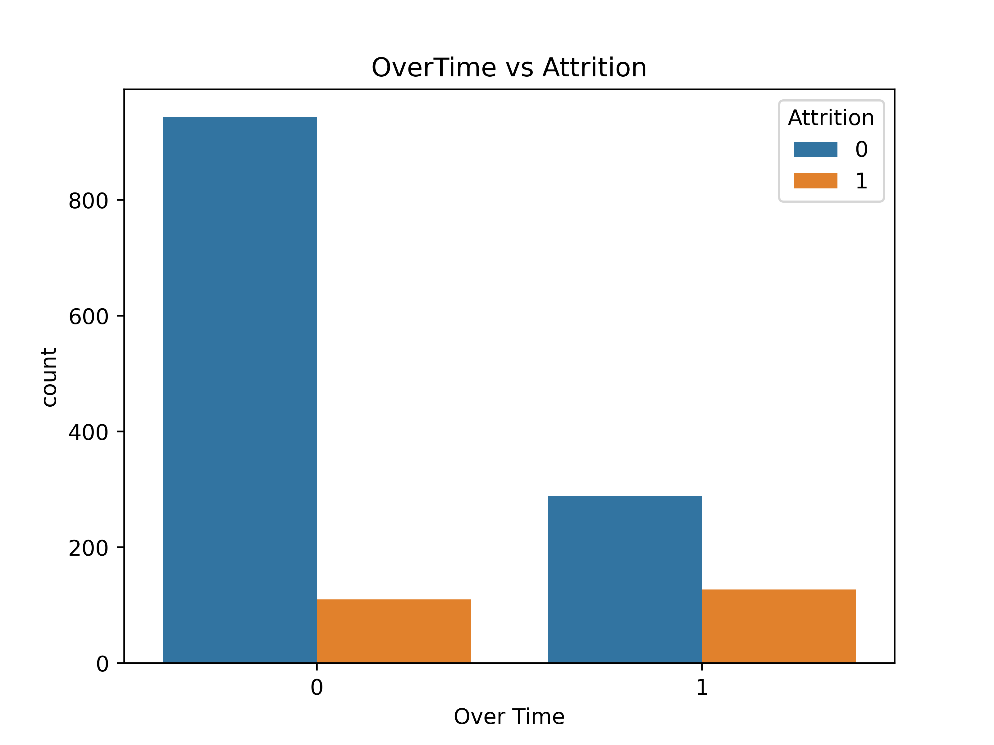
Data Analysis
2. Overtime and Attrition
Key Insight: Working overtime significantly impacts an employee's likelihood of attrition.
Observations:
Employees working Overtime (Yes): A noticeable proportion of employees who work overtime also attrite. The bar for "Yes" attrition is considerably higher relative to "No" attrition for those doing overtime.
Employees not working Overtime (No): The vast majority of employees who do not work overtime also do not attrite.
Conclusion: Overtime is a strong predictor of employee attrition. Employees consistently working overtime are at a higher risk of leaving the company.

Slide 8
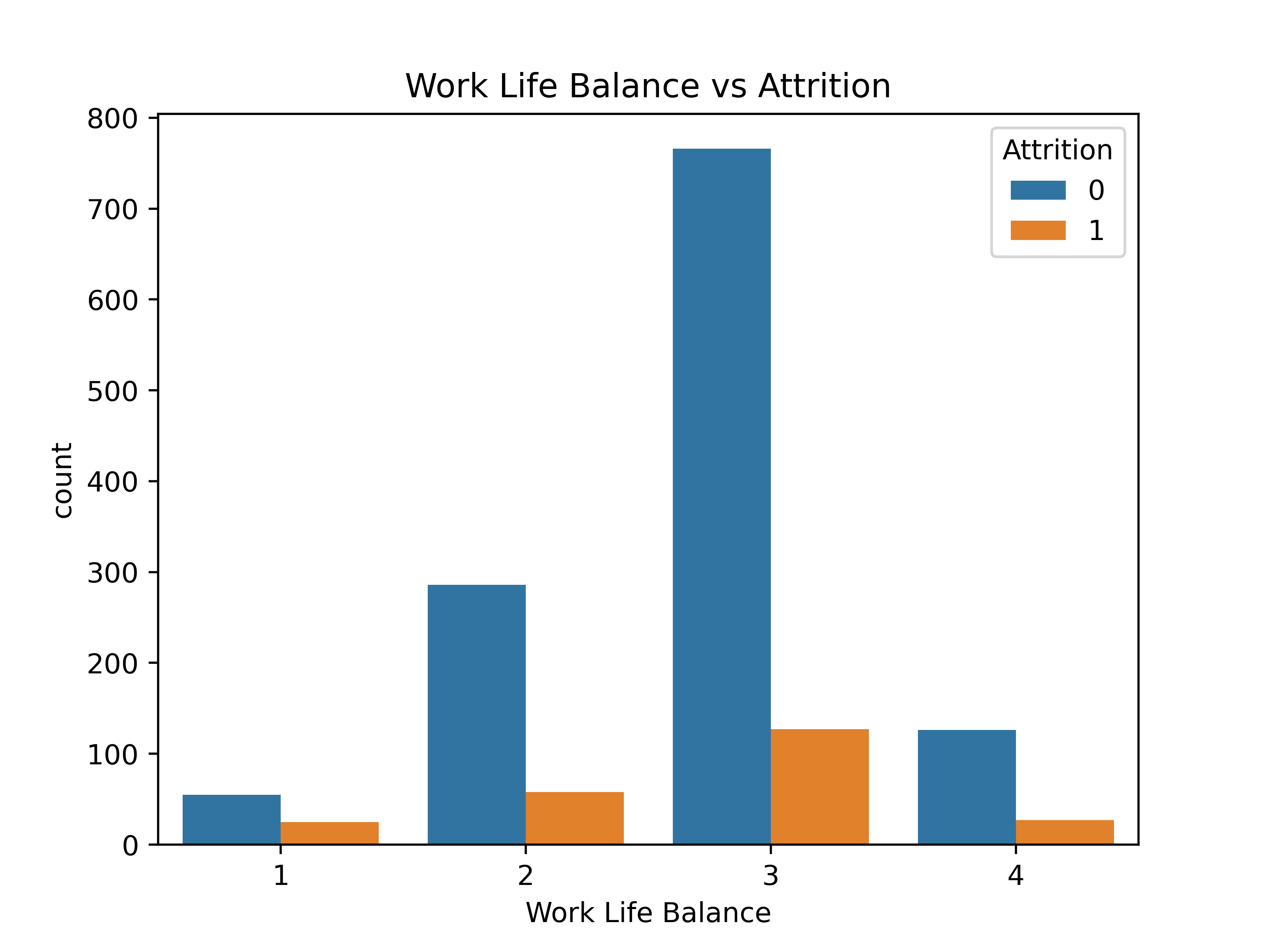
Data Analysis
3. Work-Life Balance and Attrition
Key Insight: An employee's perception of work-life balance plays a role in their decision to attrite.
Observations:
Work-Life Balance is rated on a scale (1 to 4).
Work-Life Balance 3 (Good/Average): While this category has the highest overall number of employees (and lowest attrition proportionally), some attrition still occurs.
Work-Life Balance 1 (Poor) & 2 (Fair): These categories show a relatively higher proportion of attrition compared to the number of non-attriting employees within these specific groups.
Work-Life Balance 4 (Excellent): Despite being a small group, it still sees some attrition, though proportionally less than lower ratings.
Conclusion: Employees with poorer or even average (ratings 1 and 2) work-life balance are more likely to attrite. Ensuring a healthy work-life balance is important for retention.

Slide 9
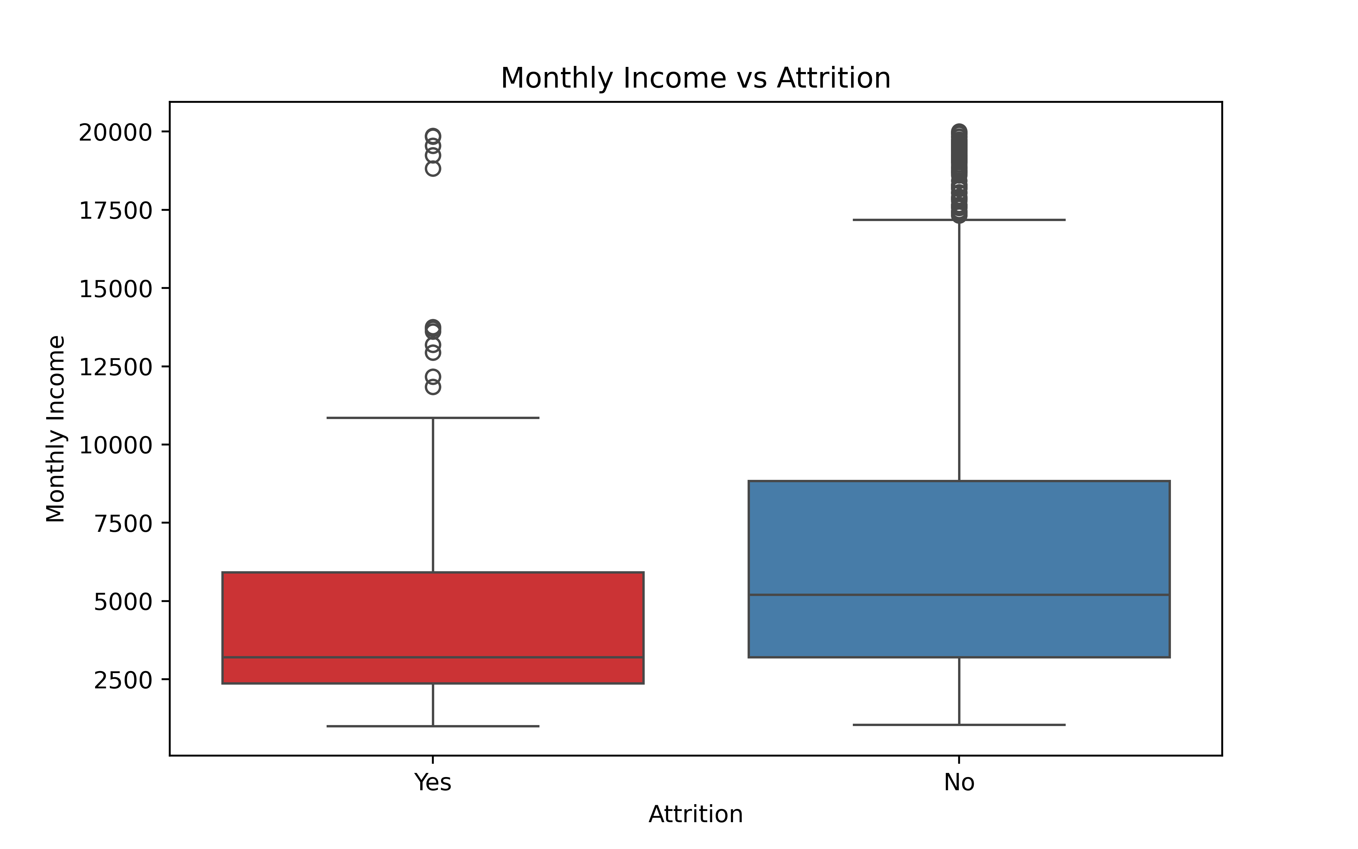
Data Analysis
4. Monthly Income and Attrition
Key Insight: Monthly income is a significant factor influencing employee attrition.
Observations:
Attrition (Yes) Group: The box plot for attriting employees shows a significantly lower median monthly income and a tighter, lower distribution of earnings.
No Attrition (No) Group: Employees who do not attrite have a much higher median monthly income and a broader income range, including higher earners.
Conclusion: Lower monthly income is strongly associated with a higher likelihood of employee attrition. This suggests that compensation competitiveness is crucial.

Slide 10
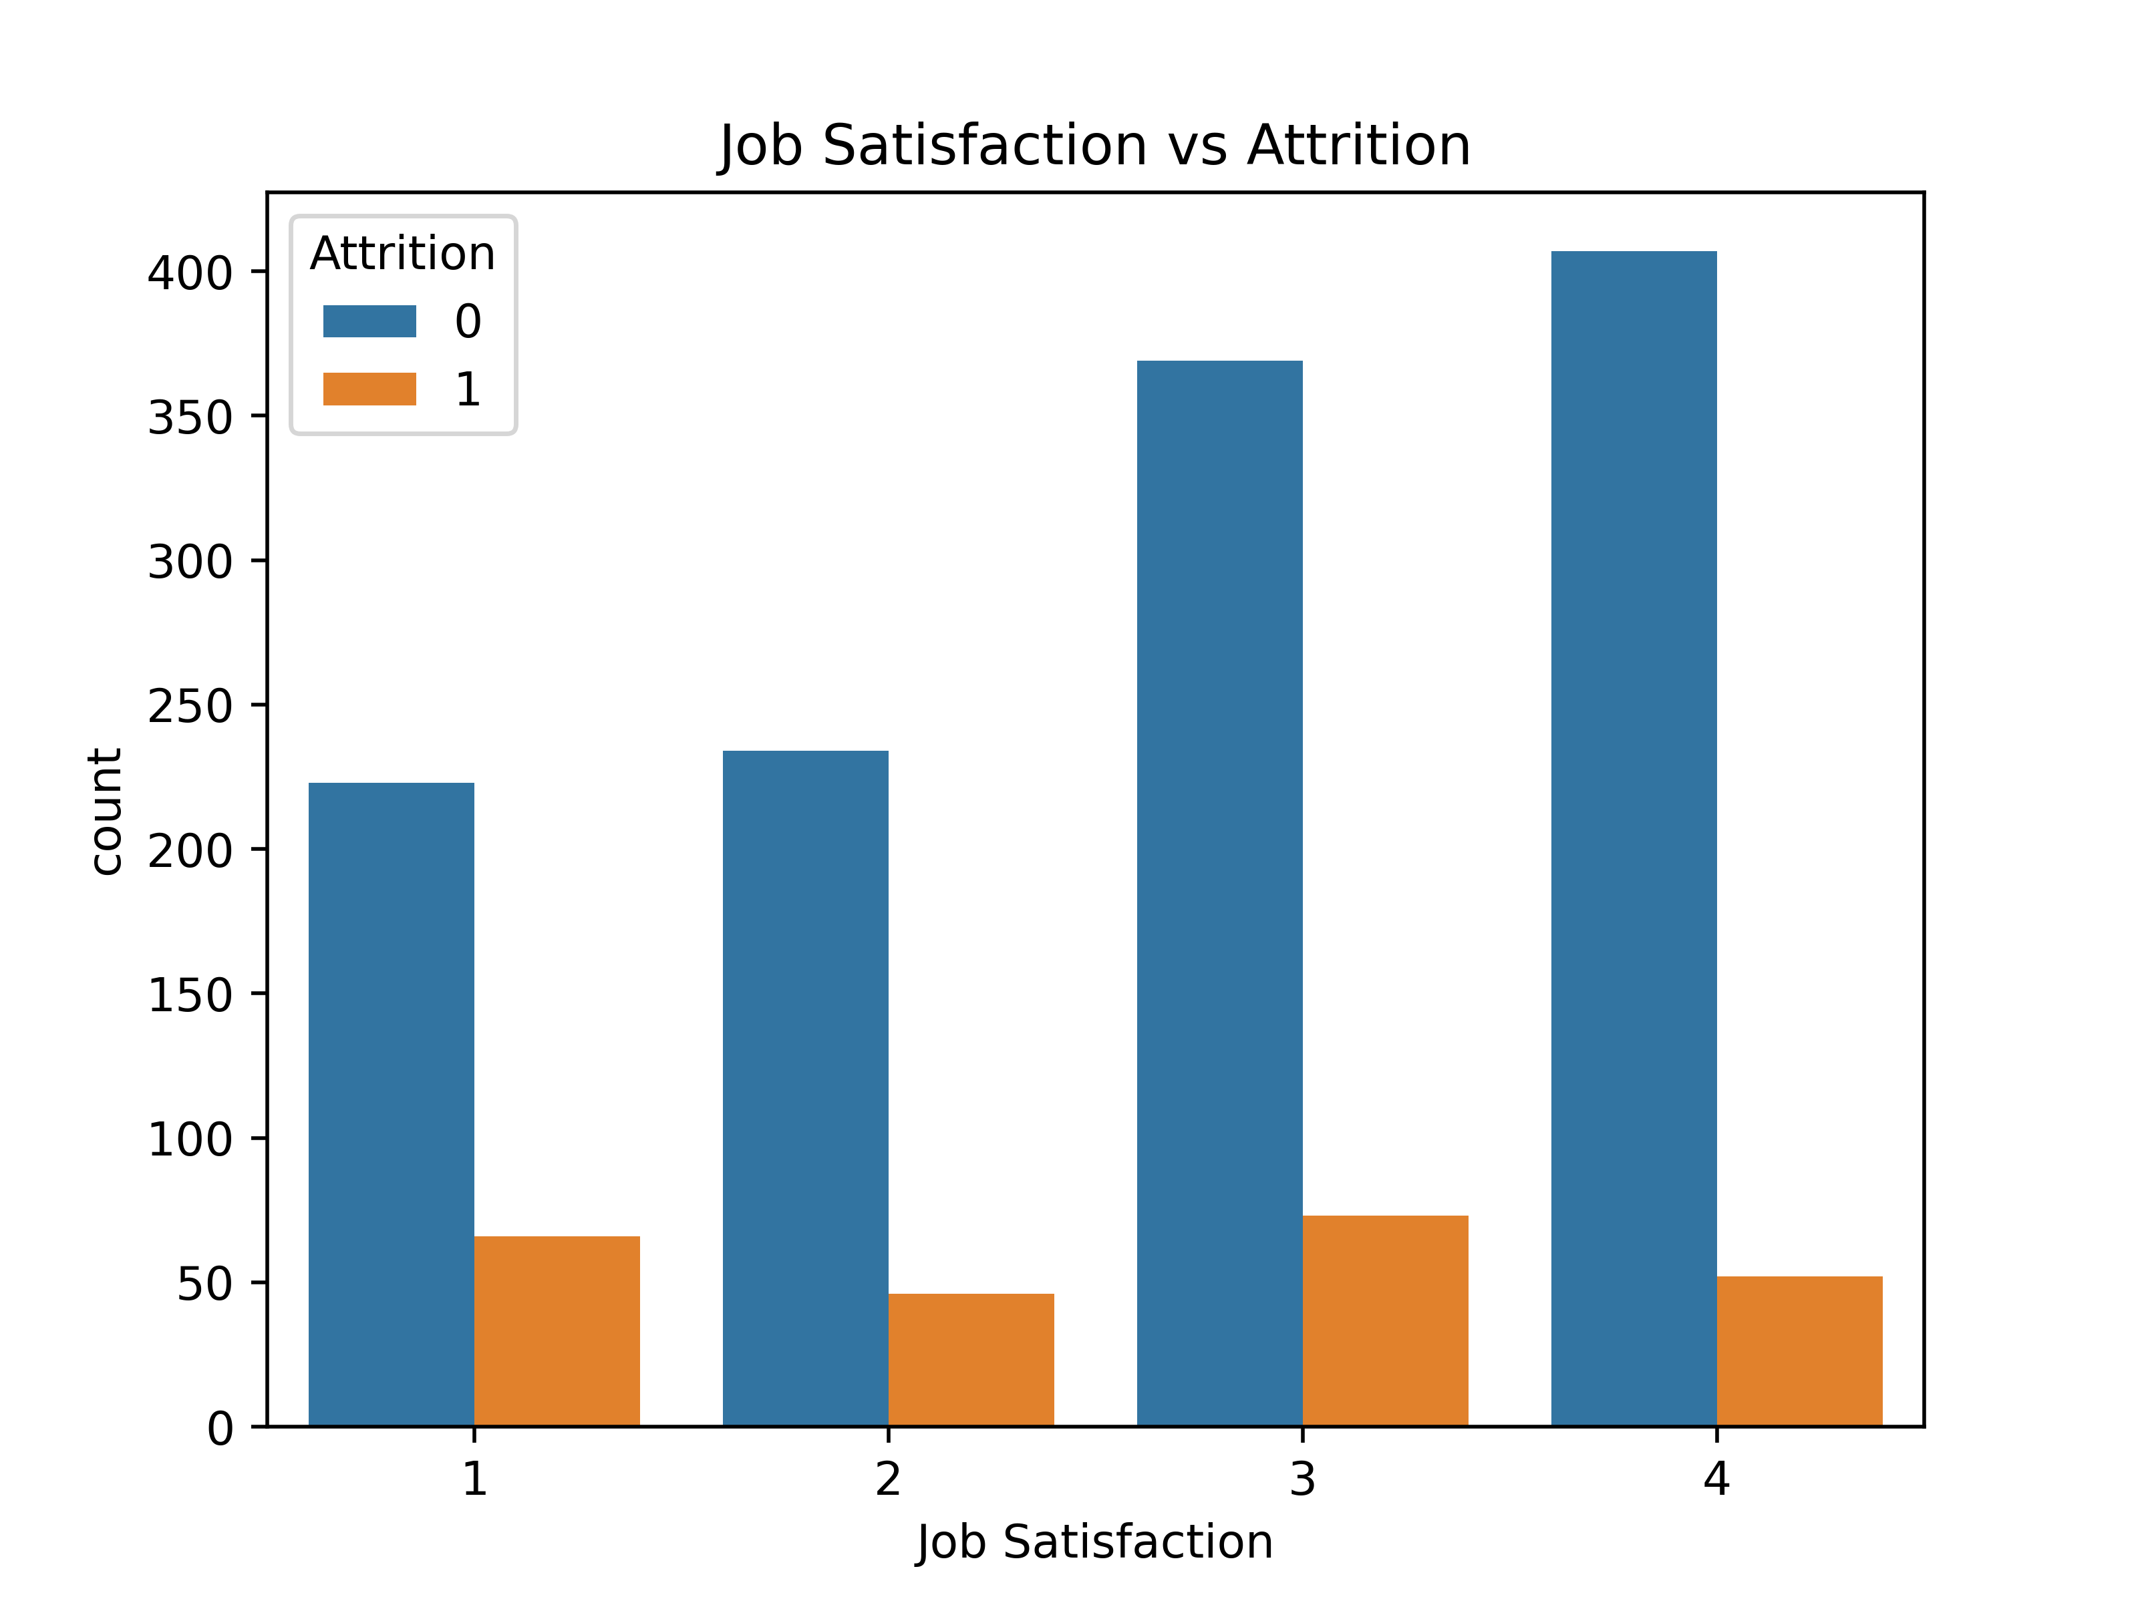
Data Analysis
5. Job Satisfaction and Attrition
Key Insight: Employee job satisfaction levels directly correlate with attrition rates.
Observations:
Job Satisfaction is rated from 1 to 4.
Job Satisfaction 1 (Low): This category exhibits a proportionally higher attrition rate.
Job Satisfaction 2 & 3: These show decreasing attrition proportions as satisfaction increases.
Job Satisfaction 4 (High): This category demonstrates the lowest proportional attrition, with a large number of employees who do not attrite.
Conclusion: Higher job satisfaction (ratings 3 and 4) leads to significantly lower attrition. Addressing factors that contribute to low job satisfaction is critical for retention.

Slide 11
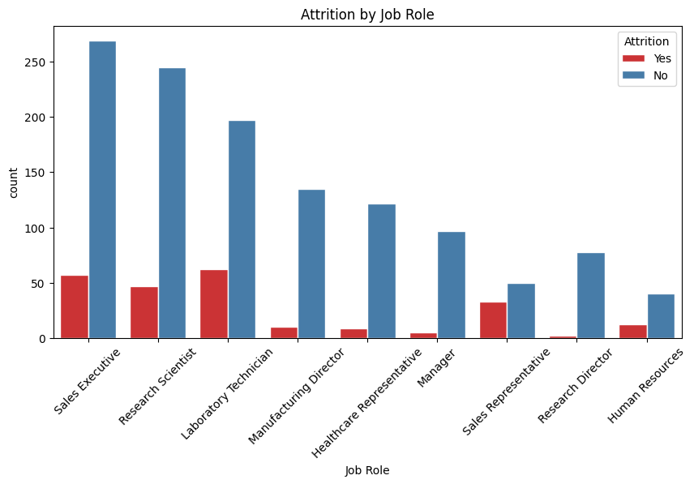
Data Analysis
6. Attrition by Job Role
Key Insight: Attrition rates vary considerably across different job roles within the organization.
Observations:
High Attrition Roles: Roles such as Laboratory Technician, Sales Representative, and Human Resources show a notably higher count of "Yes" attrition compared to "No" attrition within their specific job roles.
Lower Attrition Roles: Job roles like Research Scientist, Sales Executive, and Manufacturing Director exhibit a much larger number of non-attriting employees compared to those who attrite.
Conclusion: Certain job roles are more susceptible to attrition than others. Targeted retention strategies may be necessary for high-risk roles.

Slide 12
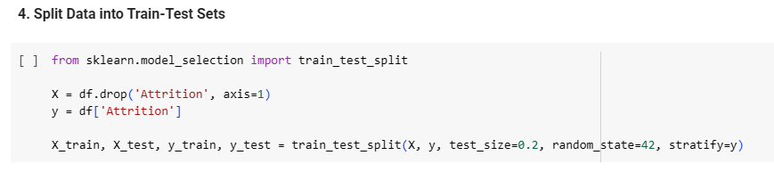
Model Building & Evaluation
Data Splitting
The pre-processed data was split into training and testing sets, with 80% for training and 20% for testing. Stratified sampling was used for the y variable (Attrition) to maintain the class distribution in both sets due to the class imbalance.

Slide 13
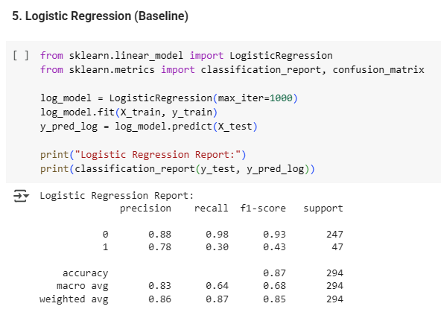
Model Building & Evaluation
Models Implemented
The following machine learning models were trained and evaluated:
Logistic Regression (Baseline):
Precision: Moderate (0.88 for 'No', 0.78 for 'Yes')
Recall: High for 'No' (0.98), Low for 'Yes' (0.30)
F1-Score: Moderate (0.93 for 'No', 0.43 for 'Yes')
Accuracy: 0.87

Slide 14
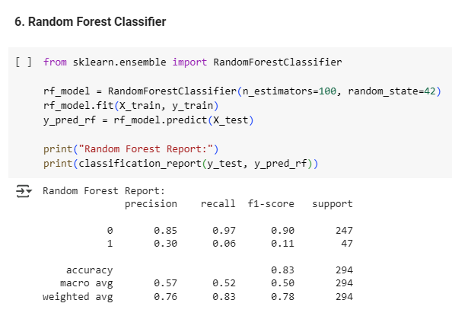
Model Building & Evaluation
Models Implemented
The following machine learning models were trained and evaluated:
Random Forest Classifier:
Precision: High for 'No' (0.85), Low for 'Yes' (0.30)
Recall: High for 'No' (0.97), Very Low for 'Yes' (0.06)
F1-Score: Moderate (0.90 for 'No', 0.11 for 'Yes')
Accuracy: 0.83

Slide 15
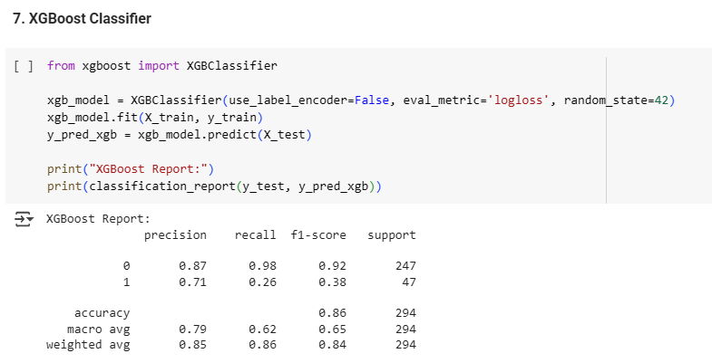
Model Building & Evaluation
Models Implemented
The following machine learning models were trained and evaluated:
XGBoost Classifier:
Precision: High for 'No' (0.87), Moderate for 'Yes' (0.71)
Recall: High for 'No' (0.98), Low for 'Yes' (0.26)
F1-Score: High for 'No' (0.92), Low for 'Yes' (0.38)
Accuracy: 0.86

Slide 16
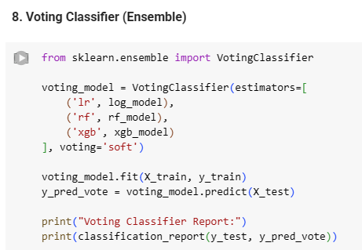
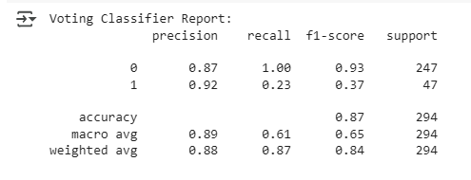
Model Building & Evaluation
Models Implemented
The following machine learning models were trained and evaluated:
Voting Classifier (Ensemble): This model combined Logistic Regression, Random Forest, and XGBoost using a soft voting approach.
Precision: Best (0.87 for 'No', 0.92 for 'Yes')
Recall: Best (1.00 for 'No', 0.23 for 'Yes')
F1-Score: Best (0.93 for 'No', 0.37 for 'Yes')
Accuracy: 0.87

Slide 17
Dynamic delivery
Learn to infuse energy into your delivery to leave a lasting impression
One of the goals of effective communication is to motivate your audience
Metric | Measurement | Target | Actual
Audience attendance | # of attendees | 150 | 120
Engagement duration | Minutes | 60 | 75
Q&A interaction | # of questions | 10 | 15
Positive feedback | Percentage (%) | 90 | 95
Rate of information retention | Percentage (%) | 80 | 85

Slide 18
Final tips & takeaways
Consistent rehearsal
Strengthen your familiarity
Refine delivery style
Pacing, tone, and emphasis
Timing and transitions
Aim for seamless, professional delivery
Practice audience
Enlist colleagues to listen & provide feedback
Seek feedback
Reflect on performance
Explore new techniques
Set personal goals
Iterate and adapt

Slide 19
Speaking engagement metrics
Impact factor | Measurement | Target | Achieved
Audience interaction | Percentage (%) | 85 | 88
Knowledge retention | Percentage (%) | 75 | 80
Post-presentation surveys | Average rating | 4.2 | 4.5
Referral rate | Percentage (%) | 10 | 12
Collaboration opportunities | # of opportunities | 8 | 10

Slide 20
Thank you
Paromita Saha
Intern Id: ITID0902
paromitasaha0720@gmail.com

